Slide 1
How to Follow Instructions

Slide 2

Exercise 1
Before beginning the Following Instructions lesson, please do this short exercise:
Read the entire exercise before starting. Use a scratch paper if necessary.
Sign your name.
Write one sentence about your favorite college class.
List three reasons why it is important to follow instructions.
Next page:
Exercise Continued

Slide 3

Exercise Continued
Write a sentence explaining what you would like to do in your future career.
Draw a happy face next to your sentence.
Now that you have finished reading everything, score your work. How many questions did you answer?
Next page:
Scoring the Exercise

Slide 4

Scoring the Exercise
If you did not answer any questions, you get
100%! You followed instructions perfectly!
If you answered any of the questions, review
the first instruction:
Read everything before starting.
You should have read the entire exercise without answering any questions first.

Slide 5
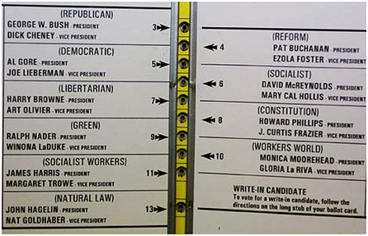
Let’s try one more exercise
If you wanted to vote for Al Gore, which circle would you ink?

Slide 6
Scoring the Second Exercise
If you picked the third circle, you are correct!

Slide 7
Explaining the Second Exercise
The second quiz shows a butterfly ballot from the 2000 Presidential election.
19,000 butterfly ballots in Palm Beach, Florida were thrown out because voters voted for more than one Presidential candidate.
These voters didn’t understand—or didn’t read—the instructions on the ballot.

Slide 8

So why is it important to follow instructions?
Following instructions will help you get a better grade on an assignment
Following instructions will help make sure that you learn the required information/skills from a class or assignment
Following instructions will help you have positive interactions with your instructors
Your employers (present or future) will expect it of you
Failure to follow instructions thoroughly could result in a failing grade.

Slide 9

Where will I find instructions?
You may find instructions in many different places. For the purposes of this lesson, we will focus on:
Syllabus
Assignment Prompts
Online class: orientation letter
In class (verbal or written)

Slide 10

Syllabus
A syllabus is both a course outline and a contract.
Course outline: The syllabus will let you know what books are required, what assignments you will complete, and what you are supposed to learn in the class.
Contract: The syllabus will provide information on how the instructor will determine your grade. In addition, it includes important policies that you should know.

Slide 11

Syllabus Components
You can expect to see the following components in most syllabi:
Required Books
List of Assignments
Grading Policy
Attendance/Drop policy
Academic Integrity Policy
Office Hours/Location
Instructor’s contact information
Disability accommodation
Student Learning Outcomes
Assignment/Reading Calendar

Slide 12

Using the Syllabus
Instructors expect students to be familiar with the policies listed in the syllabus. They often do a great deal of work to make sure all their policies are clear to their students.
Bring your syllabus to class.
Review the syllabus periodically.
Check the syllabus before asking a question about course policies.

Slide 13

Activity 1
Read through the sample syllabus in the handout.
Take notes for yourself; underline the most important information.
Answer the syllabus questions on the handout.

Slide 14

Assignment Prompts
The assignment prompt gives students instructions on how to complete an assignment.
Some prompts are long; be prepared to read the entire document.
Instructors design prompts to help you succeed.
If students do not follow the instructions on the prompt, they may receive a failing grade for the assignment.

Slide 15
Assignment Prompt Components
You can expect to see some of the following components in most assignment prompts:
Due date
Grading
Assignment value: How much is the assignment worth?
Rubric: How will the instructor determine your grade?
Task: What do you have to do to complete the assignment?
Question(s) that you should answer
Key words that tell you how to respond
Steps to complete the assignment successfully
Background information
Formatting Instructions: What should the assignment look like?
Requirements
Research: Do you need it? How much?
Length
Submission (www.turnitin.com, for example)
Warnings: What happens if you don’t follow instructions?
Calendar/Writing process: What drafts are due when?
Sample topics: What could you write about?

Slide 16

Using an Assignment Prompt
Read the assignment prompt thoroughly, several times, before you begin work.
Make sure that you understand what the prompt is asking you to do. Look up any unfamiliar words.
Write notes on the prompt, emphasizing the most important information.
Notice the instructor’s formatting; s/he wants you to pay extra attention to the text in bold, for example.
Use the prompt as a checklist before you submit your assignment.

Slide 17

Activity 2
Read through the sample assignment prompt in the handout.
Take notes for yourself; underline the most important information.
Answer the prompt questions on the handout.

Slide 18

Using the Prompt as a Prewriting Tool
Once you thoroughly understand an writing prompt, you can use the prompt as a prewriting tool.
Use the prompt to help you:
Define the writing task
Find your role as a writer
Address your audience appropriately
Integrate convincing evidence and examples
Use the required format

Slide 19

Define the Writing Task
As you begin work on your assignment, it is important to use the assignment prompt to answer the following questions:
What, exactly, are you supposed to do for this assignment?
What is your purpose in completing the assignment? In other words, what are you trying to achieve?
What key words does the prompt use? (See examples on the next slide.)
What vocabulary should you use in your answer?

Slide 20
Key Words that Shape the Writing Task
Key Word | Definition
Describe | Write a detailed account of
Illustrate | Make clear through examples
Explain | Make clear by giving details or reasons
Summarize | Give a brief overview of the main points
Discuss | Objectively write about
Compare | Write about the similarities of
Contrast | Write about the differences of
Analyze | Examine the parts of something to better understand them and how they fit together
Evaluate | Determine the worth or quality of something after considering its strengths and weaknesses
Remember—some prompts will ask you to use more than one of these key words!

Slide 21

Find Your Role as a Writer
The prompt may also give you hints about the role you should take. As you prepare to write, answer the following questions:
What do you want to the audience to think of you after reading your work?
How can you show that you are credible?
As a writer, you have an opportunity to be interesting. Most instructors would rather read an interesting assignment than a boring one.

Slide 22
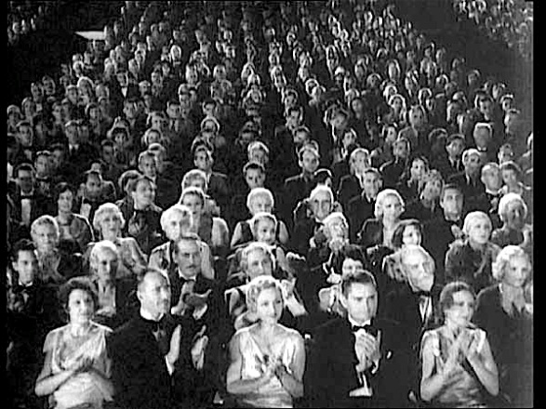
Address Your Audience Appropriately
Consider who you are writing to, and shape your assignment to meet the audience’s expectations.
Who is your audience?
What do they care about?
What will they be looking for in your writing?
How can you meet their needs?
How will the audience’s expectations affect your writing style?

Slide 23

Integrate Convincing Evidence and Examples
The prompt may tell you what type of information you should use to complete the assignment.
How much research do you need to complete this assignment?
What past information from the class will help you?
What outside sources are acceptable?
How many outside sources are required?
What types of research, evidence, or examples will be convincing to your audience?

Slide 24
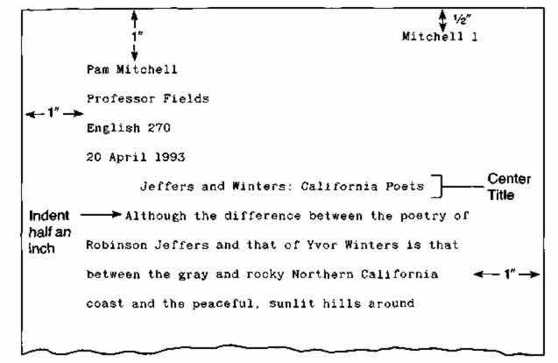
Use the Required Format
The prompt may also give you information about the assignment format.
What type of document are you supposed to write?
Essay
Report
Letter
What does that document look like?
Does the instructor include any specific formatting instructions for you to follow?

Slide 25

Activity 3
Read the sample essay question on your handout.
Annotate the essay question, paying special attention to key words that dictate what kind of essay you should write.
Write a paragraph that explains how you would approach this essay if you were assigned it in class.

Slide 26

Other Places for Instructions
Online Classes, especially the Orientation Letter
In class, either spoken or written

Slide 27

Online Classes
Success in an online class requires you to read instructions thoroughly on your own.
You do not meet with an instructor in person.
Most (if not all) of the instructions are delivered in writing.
Be sure to read the orientation letter and syllabus thoroughly; they will set you up for success in the class.
Before registering for an online class, take an assessment to make sure you are ready for the online learning environment.

Slide 28

Instructions in Class (Spoken or Written)
Your instructor will issue instructions during class.
Be sure to pay close attention, especially if the instructions are only spoken.
Take careful notes; for more information, you can take the Guided Learning Activity on Note Taking.
Ask questions to clarify the instructions.

Slide 29

How to Ask for Help
If you are struggling with a class or assignment, there are several places you can go for help, such as:
Instructor’s Office Hours
The Learning Center (TLC)
Before you ask for help, though, carefully review any instructions you have been given.

Slide 30

Asking Your Instructor for Help
Determine your purpose: What do you need help with?
Determine the best time to meet. You can ask questions before and after class, by email or phone, or during office hours.
If your question is likely to take a significant amount of time to answer, make an appointment to visit office hours.
Ask your question well in advance of due dates. Instructors are likely to be unreceptive immediately before an assignment is due.

Slide 31

Talking with Your Instructor
Have your questions prepared in advance. Write them down so you don’t forget what you want to say.
Come prepared. Bring a pen, paper, syllabus, and assignment prompt.
Be on time, especially if you’ve made an appointment outside of regular office hours.
Call your instructor by his/her last name unless s/he has invited you to do otherwise.
Show gratitude. Thank the instructor for his/her help.

Slide 32

Overcoming Fear
Often, students seek out professor’s help because they are experiencing a problem (like falling behind in their assignments).
They may feel afraid or intimidated by the idea of talking to the professor alone.
In order to succeed in college, though, it is necessary to set aside fear and ask for the help that you need.

Slide 33

Preparing for a Tutoring Session at The Learning Center
Bring the assignment and a printed draft of your work
Prepare questions for a tutor in advance
Expect to spend about 30 minutes with a tutor working on 2-3 main areas in your assignment
Don’t forget your student ID!

Slide 34

If you liked this lesson and would like more information, consider attending:
Test Taking Strategies
Timed Writing
Note-Taking
Why should you come back?
Students completing Supplemental Learning Activities had a 10% higher success rate across the disciplines, a 21% higher success rate in Math, and a 49% higher success rate in English courses.

Slide 35

Reflection
Answer the reflection questions on your handout.
Discuss your answers to the activities with a tutor.

